Slide 1
Multimodality and Large Multimodal Models (LMMs)
Presented by Aryan Bhardwaj, Aman Gupta, Divya Machineni, Aydan Pirani
Paper author: Chip Huyen, huyenchip.com

Slide 2
Understanding Multimodality
Notes:
What is multimodality
Incorporating data from multiple modals each that has its own data model.
For example, multimodality could be one that learns from text and images
We do that in order to boost model performance. a model that can learn from both text and images perform better than a model that can learn from only text or only image

Slide 3
What is data multimodality?
One data mode can be represented or approximated in another data mode
Incorporating data from other modalities can help boost model performance
Can provide a more flexible interface, allowing you to interact with them in whichever way works best for you
Notes:
One data mode can be represented or approximated in another data mode
speech can be transcribed into text (but lose volume, intonation, pauses)
image can be represented as a vector, which can be flattened into a sequence of text tokens
video = sequence of images + audio
Audio can be represented as images
Incorporating data from other modalities can help boost model performance
All digital data formats can be represented using bitstrings (strings of 0 and 1) or bytestrings
A model that can effectively learn from bitstrings or bytestrings will be very powerful, and it can learn from any data mode.
Can provide a more flexible interface, allowing you to interact with them in whichever way works best for you
Audio is still mostly treated as a voice-based alternative to text
Most common use cases are speech recognition (speech-to-text) and speech synthesis (text-to-speech)
Image is most versatile (can represent text, tabular, data, audio, videos)

Slide 4
Multimodal tasks
Generation (Image generation + Text generation)
Vision-language understanding
Classification
Can only generate outputs that belong to a predetermined list of classes
ex. OCR system predicts one of known characters
Text-based image retrieval (TBIR)
Generate captions and metadata for each image.
Train joint embedding space for both images and text.
Notes:
To understand multimodal systems, it’s helpful to look at the tasks they are built to solve.
These tasks are split into two main categories: Generation and Vision-language understanding
GENERATION
Everyone is familiar with generation,
Image (dall-e, stable diffusion, midjourney)
Text generation (point your camera to something, get that image, and ask a question to generate a text response)
Captioning: the model can look at the photo and automatically generate captions for them
VISION-LANGUAGE UNDERSTANDING
Classification (character recognition with known list of labels)
Text-based image retrieval
Generate captions and metadata for each image. Given a text query, find images whose captions/metadata are closest to this text query
Train joint embedding space for both images and text. Given a text query, generate an embedding for this query, and find all images whose embeddings are closest to this embedding

Slide 5
CLIP: Contrastive Language-Image Pre-training

Slide 6
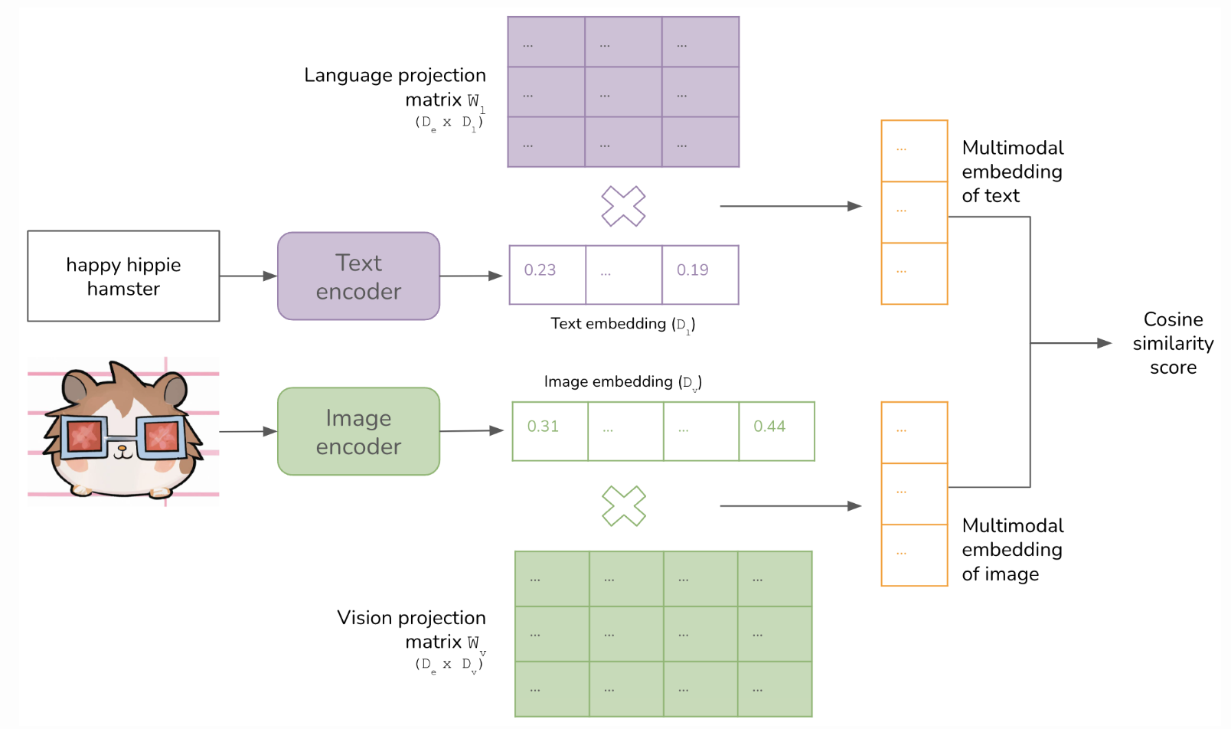
CLIP
CLIP high-level architecture
Notes:
The same as the CLIP architecture from stable diffusion
Image encoder. Authors experimented with both ResNet and ViT (large vision transformer)
Used a Large vision transformer (ViT-L)
Each image divided into 14 patches
Text encoder
uses a Transformer model similar to GPT-2 but smaller
63M parameters and 8 attention heads
Embeddings created by the image and text encoder are projected into the same embedding space using two projection matrices W_v and W_l.
Both encoders and projection matrices are jointly trained together from scratch. The goal is to maximize the similarity scores of the right (image, text) pairings while minimizing the similarity scores of the wrong pairings (contrastive learning).
Key contribution - ability to map data of different modalities, text and images, into a shared embedding space
Both encoders and projection matrices are trained together
Image encoder: can be utilized for zero-shot generalization

Slide 7
CLIP
Classifier and language model objectives
Pre-CLIP, most vision-language models were trained using a classifier or language model objectives.
Classifier objective
Predicts correct class amount a predetermined list of classes
Constrains the model’s ability to generate meaningful responses and limits its zero-shot learning capability
Language model objective
Training is difficult because model tries to generate exactly the text accompanying each image, while many possible texts can accompany an image
Notes:
Predicts correct class amount a predetermined list of classes (works when output space is finite)
If a classifier outputs only one class for each input, a language model outputs a sequence of classes
Language model makes training difficult because the model tries to generate EXACTLY the text accompanying each image, while many possible texts can accompany an image

Slide 8
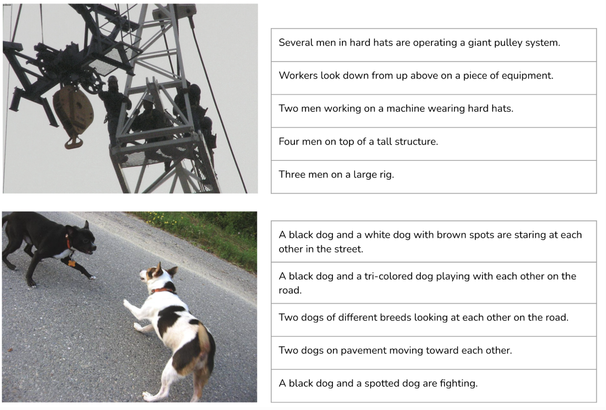
CLIP
Contrastive objective
Allows CLIP to scale and generalize to multiple tasks.
Instead of predicting the exact text of each image, CLIP was trained to predict whether a text is more likely to accompany an image than other texts.
Notes:
Contrastive objective is a clever technique that allows CLIP to scale and generalize to multiple tasks.
Instead of predicting the exact text of each image, CLIP was trained to predict whether a text is more likely to accompany an image than other texts.

Slide 9
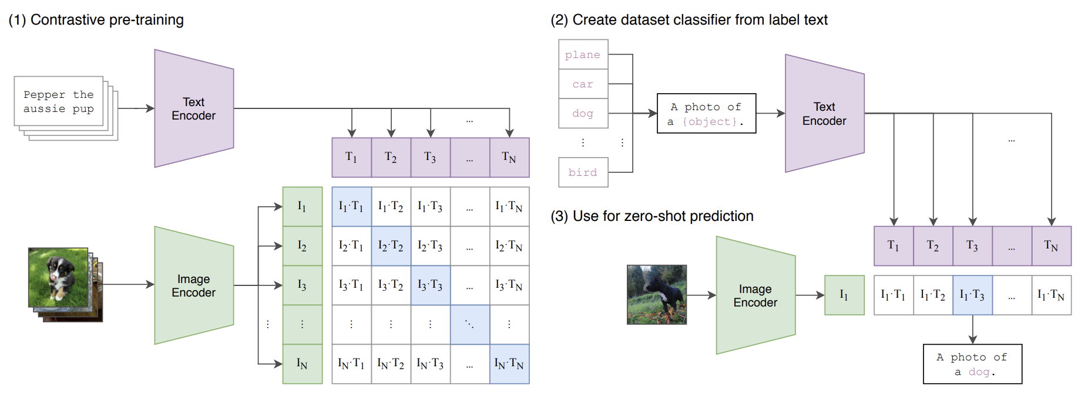
CLIP
Contrastive objective

Slide 10
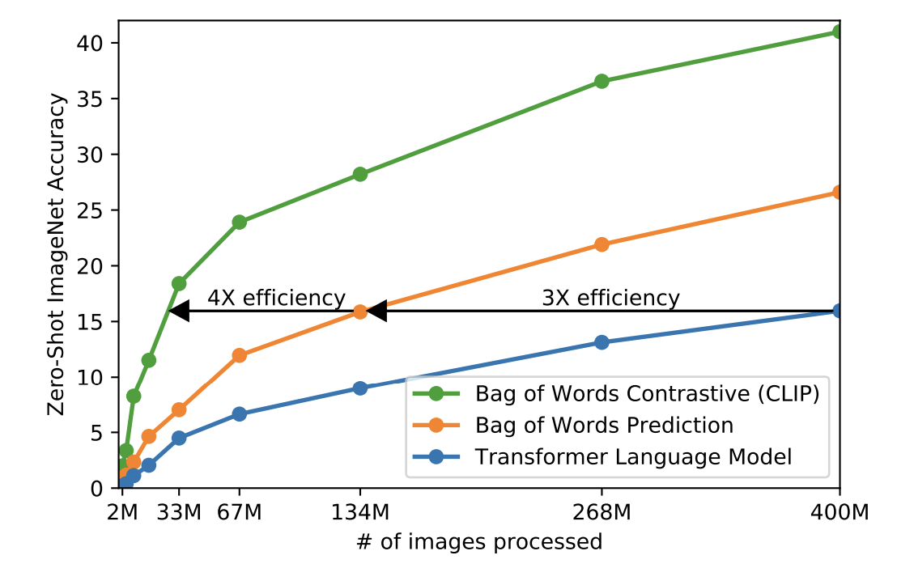
CLIP
Efficiency Improvements

Slide 11
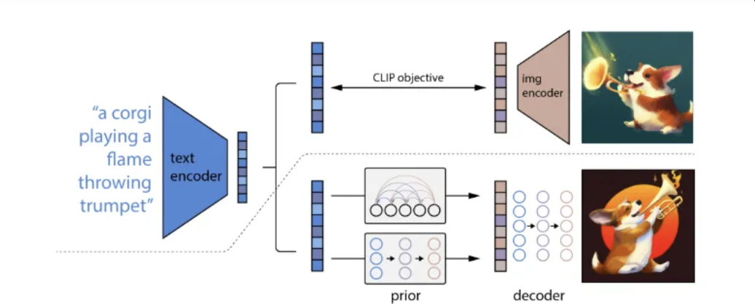
CLIP
Clip Applications
Classification
Text-based image retrieval
Image generation
DALL-E generates many visuals and uses CLIP to rerank these visuals before showing top visuals
unCLIP = text-to-image synthesis model conditioned on CLIP latents
use CLIP to generate embedding for this text
Use a diffusion decoder to generate images conditioned on this embedding

Slide 12
Flamingo

Slide 13
Flamingo
Flamingo: the Dawns of LMMs
Can generate text responses (unlike Clip)
Essentially Clip + language model
Flamingo is not an open-sourced model
Notes:
Like an extension to CLIP

Slide 14
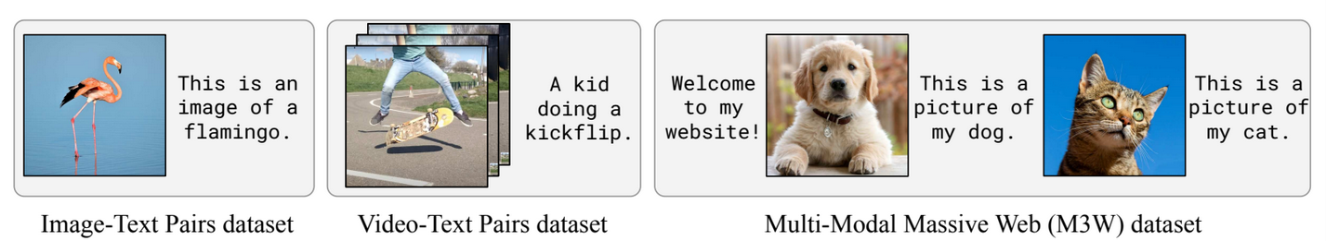
Flamingo
Flamingo Datasets
1 interleaved image and text dataset (M3W)
2 (image, text) pair datasets (ALIGN, LTIP)
1 (video, text) pair dataset (VTP)

Slide 15
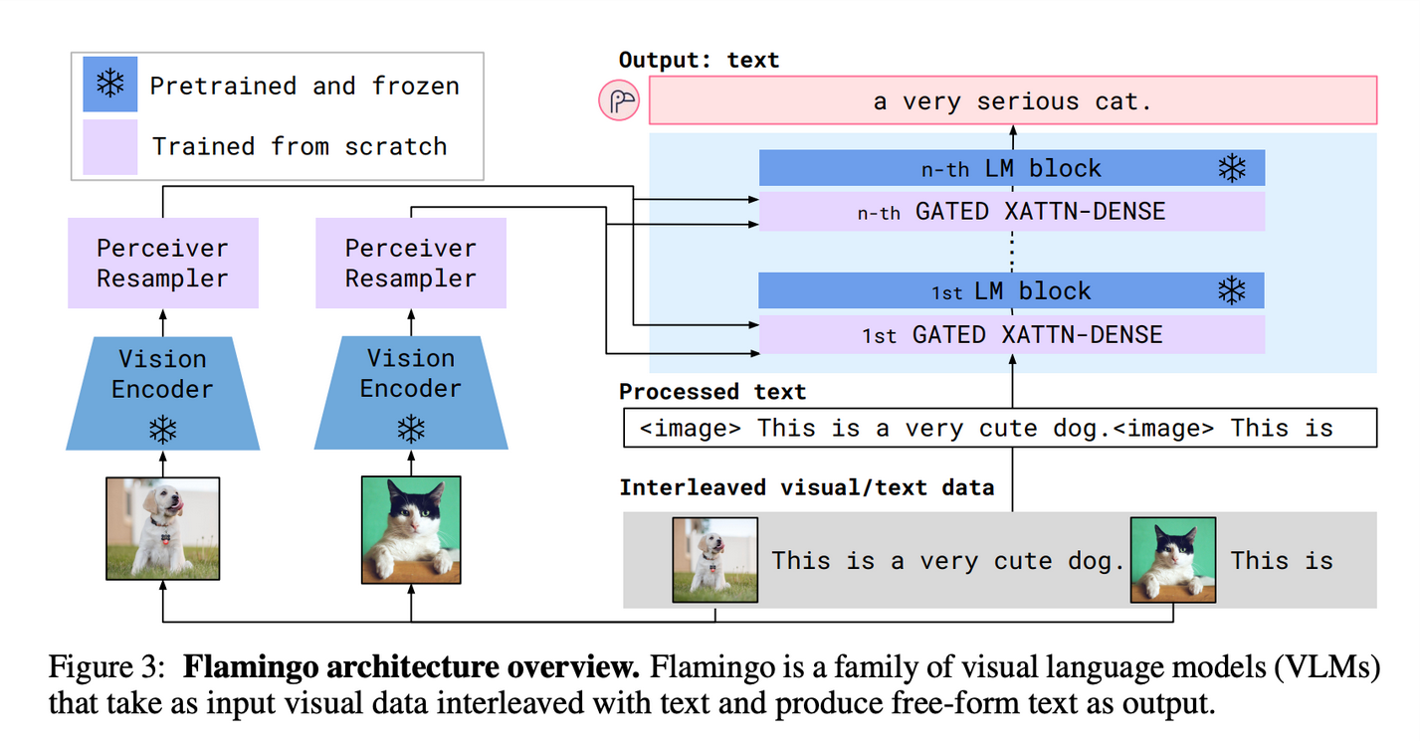
Flamingo
Flamingo Architecture
Vision Encoder
Language Model

Slide 16
Flamingo
Flamingo Vision Encoder
Train CLIP-like model from scratch
(image, text) pairs are used
Throw away the text encoder of the vision model
BERT, NormalizerFreeResNet
Notes:
Train CLIP using contrastive learning, so using only the image, text pair datasets

Slide 17
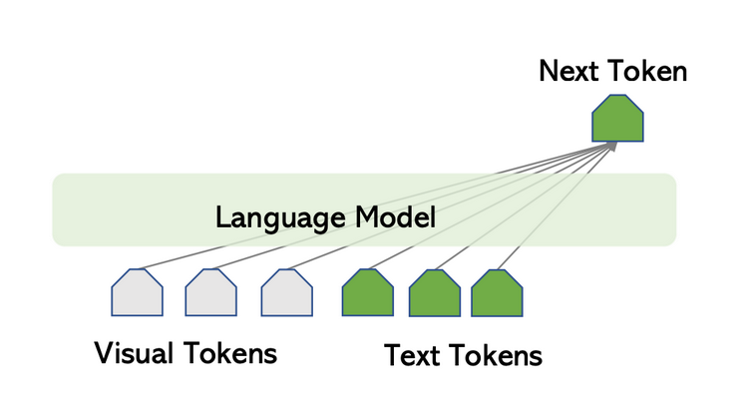
Flamingo
Flamingo Language Model
Taken from Chinchilla LM
Predicts the next text token based on preceding text + visual tokens
Relies on Perceiver Resampler and GATED XATTN-DENSE layers

Slide 18
Flamingo
Flamingo Perceiver Resampler
Images and videos’ outputs are in different dimensions
Converts variable features into fixed-size visual outputs

Slide 19
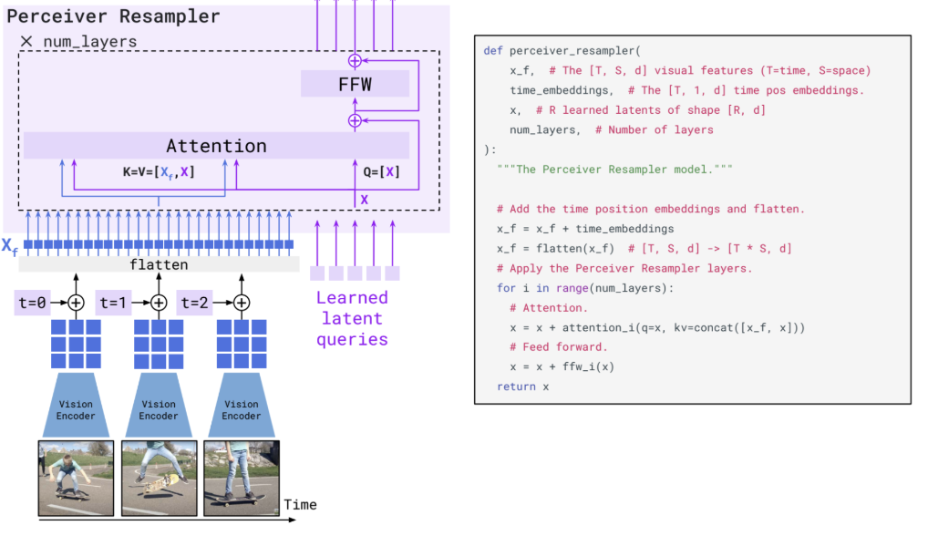
Flamingo
Flamingo Perceiver Resampler

Slide 20
Flamingo
Flamingo GATED XATTN-DENSE layers
Exists in between the existing (frozen) LM layers from the pre trained Chinchilla
Allows model to “re-focus” on the visual tokens and generate text tokens
Without it, overall score dropped 4.2%

Slide 21
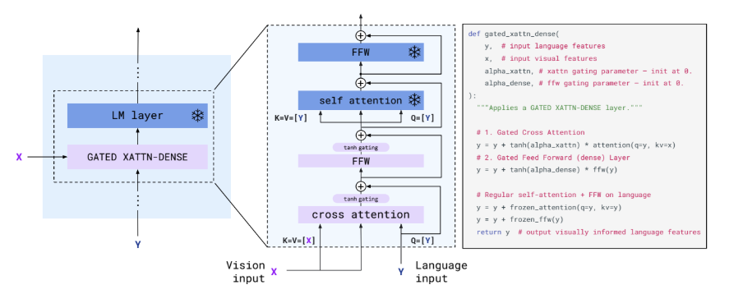
Flamingo

Slide 22
Flamingo
Training
Only the Perceiver Resampler and GATED XATTN-DENSE layers are trained from scratch
the Chinchilla LM layers are fine tuned and frozen, the additional components are trained from scratch
Uses all 4 Flamingo datasets (each has different learned weights)
M3W → 1.0
ALIGN, LTIP (image, text pairs) → 0.2
VTP → 0.03

Slide 23
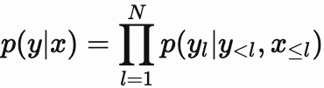
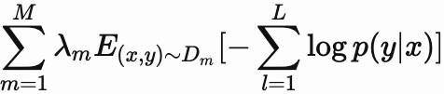
Flamingo
Loss Function
“Weighted sum of expected negative log-likelihoods of generated text across all 4 datasets, with λm being the training weight of dataset m”

Slide 24
CLIP vs. Flamingo

Slide 25
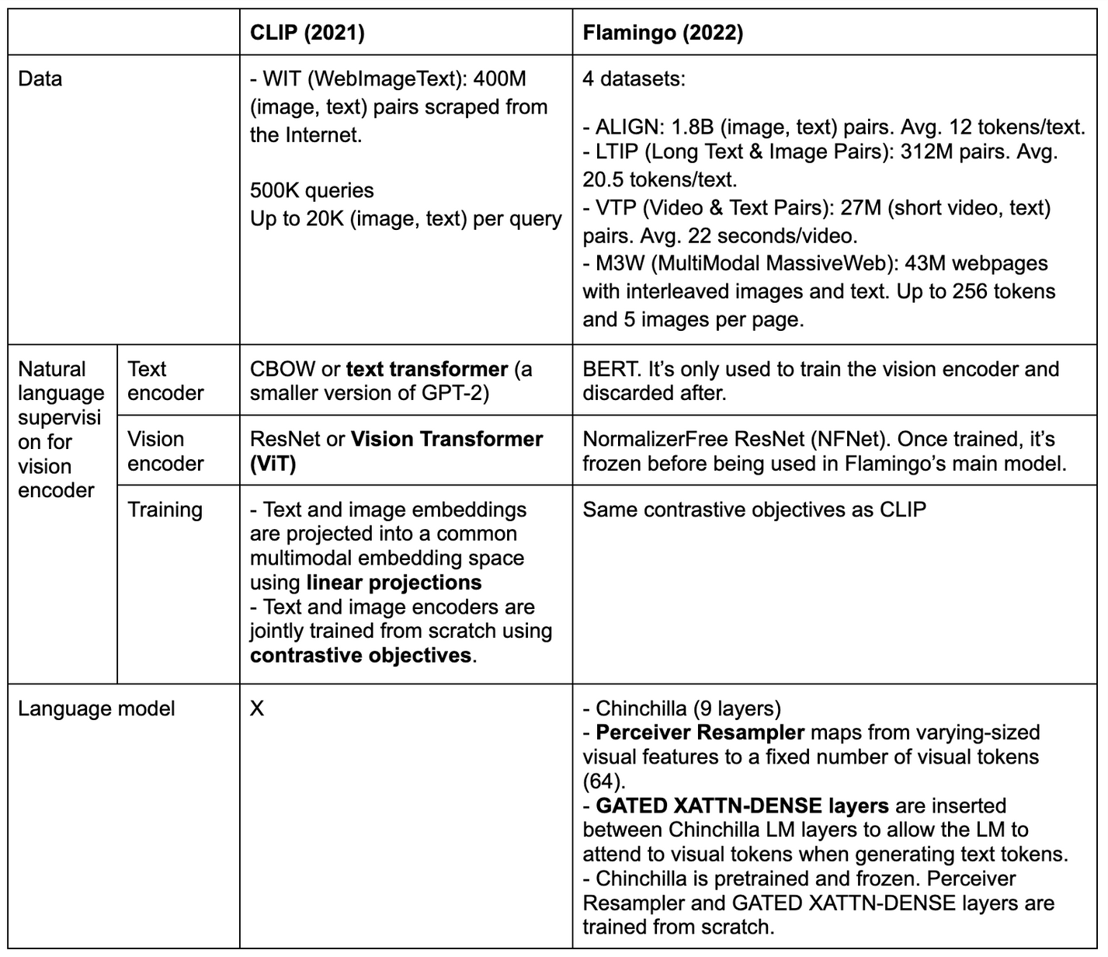
CLIP vs. Flamingo
Source: huyenchip.com/2023/10/10/multimodal.html

Slide 26
Active Research Areas

Slide 27
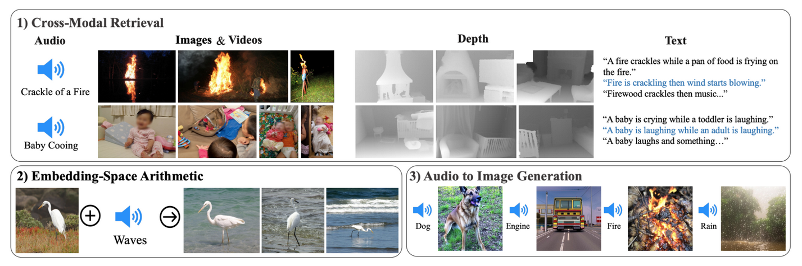
More Data Modalities
One shared embedding space
Incorporating videos, music, 3D
Pathways: an AI architecture that will handle many tasks, learn quickly and better understand the world

Slide 28
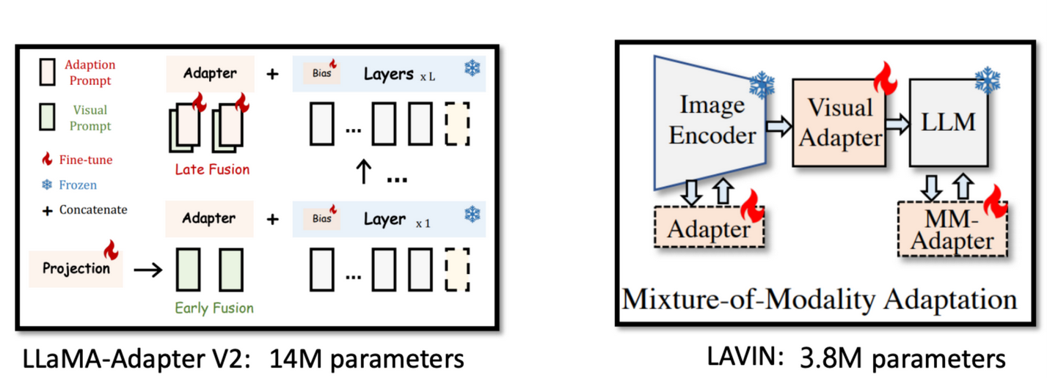
Multimodal Systems For Instruction-Following
Flamingo was trained for completion, but not for dialogue or for following instructions
Completion: next word generation
Dialogue: Getting the responses that users actually want
Eg. “how to make pizza”: “for a family of six?” vs. actual output

Slide 29
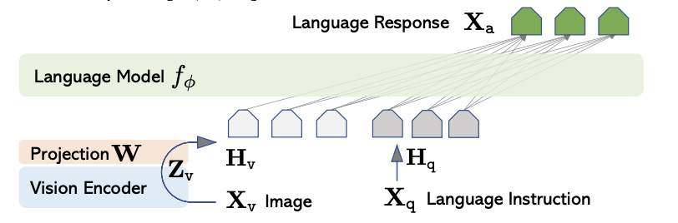
LLaVA: Multimodal Chatbot
Notes:
Pre-trained Vision Encoder taken from CLIP Image Encoder
Very similar to Flamingo
Uses multiple turns of question-responses with detailed description and understanding of both the image and the question

Slide 30
LLaVA Training
Two main steps to training, both making use of GPT-4 outputs
Keep the encoder and LLM weights fixed for this step. For each image-text pair, create a simple descriptive question X_q. Train the Projection Matrix W.
Keep encoder weights fixed. For each image-text pair, pass the text through GPT-4 to create three questions: Conversation, Detailed Description, Complex Reasoning. Train both the matrix W and the Language Model itself.
Notes:
with 500K training image-text pairs
GPT-4 simply asked to give a question that will output description of image: X_q is a randomly sampled basic question about image description and X_a ground truth is original caption
types:
Conversation: A diverse set of questions are asked about the visual content of the image, including the object types, counting the objects, object actions, object locations, relative positions between objects
Description: GPT-4 selects from a list of detailed questions and answers it
Reasoning: requires step-by-step logic, GPT-4 again selects from list of such questions

Slide 31
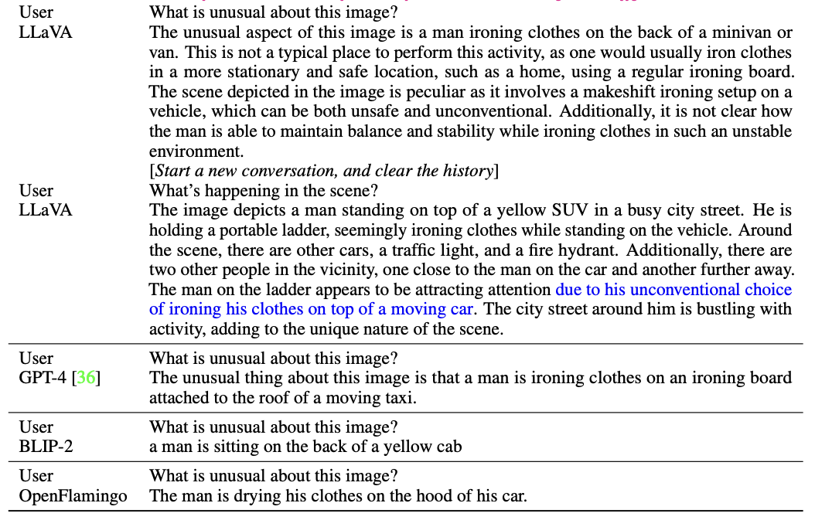
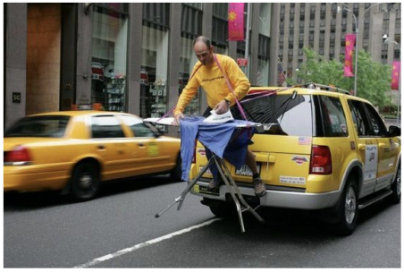
Notes:
“ LLaVA accurately follows the user’s instructions, instead of simply describing the scene. LLaVA offers a more comprehensive response than GPT-4. Even when merely asked to describe the image, LLaVA identifies atypical aspects of the image.”
The model was evaluated by text-only GPT-4 comparing its own outputs to LLaVA outputs

Slide 32
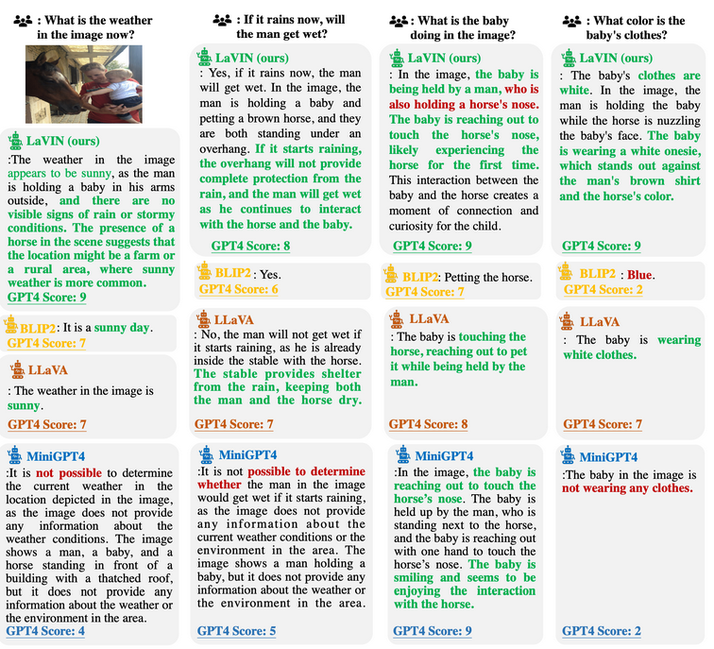
LaVIN

Slide 33
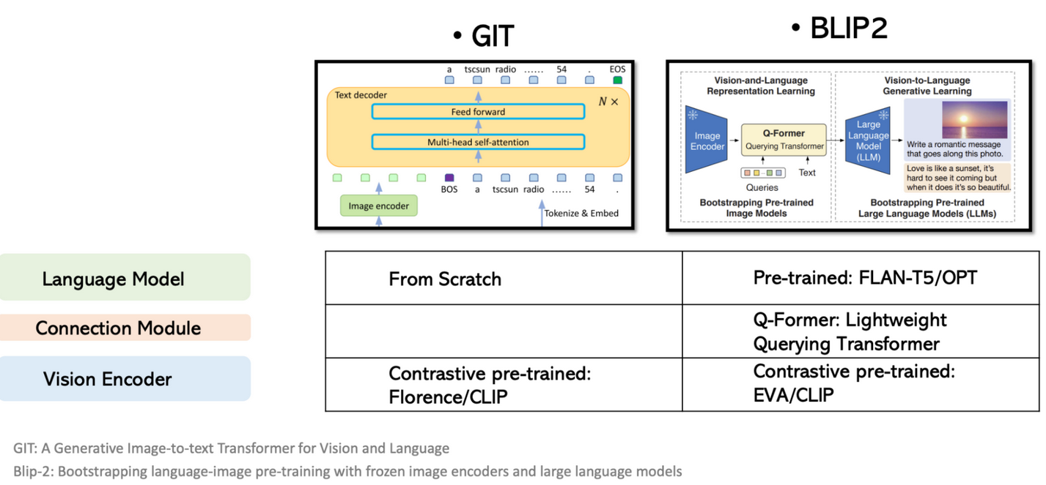
Adapters For More Efficient Multimodal Training
Problem: pretrain vision encoder, Perceiver Resampler, and GATED XATTN-DENSE layers
Compute-intensive operation
Bootstrap multimodal systems, less training?
BLIP-2, outperformed Flamingo-80B by 8.7%

Slide 34
Generating Multimodal Outputs
Need to generate an intermediate output, then convert to text/images
Could also use text as intermediate output
Eg. CM3 uses HTML markup, GPT4-V uses LaTeX
Can also use multimodal tokens
Tokens have tags to denote if they’re image or text, image tokens in diffusion, text tokens in LM

Slide 35
More Recent Multimodal Models
OpenAI GPT-4V (text, image, voice)
OpenAI GPT-4o (text, image, voice) and is better than above
OpenAI DALL-E 3, SORA
Google Gemini (text, images, audio, code, and video)
Meta ImageBind (text, visual, audio, visual, 3D depth, thermal, and movement)
Anthropic Claude 3.5 Sonnet (text, images)
LLaVA (image, text)
NExT-GPT (text, images, audio, and video )
Inworld AI (speech, text, and behavioral inputs)
Runway Gen-2 (specializes in video generation)
To read more about this, go to: https://medium.com/@zilliz_learn/top-10-best-multimodal-ai-models-you-should-know-44a96c56d79c

Slide 36
Thank you for listening!

